Slide 1

SMART INDIA HACKATHON 2026
TITLE PAGE
Problem Statement ID – SIH26192
Problem Statement Title- Flash Flood Prediction System for Hilly Regions using Multi-Source Data Theme.
Theme- Disaster Management
PS Category- Software
Team ID- DM09
Team Name- Elites1417

Slide 2
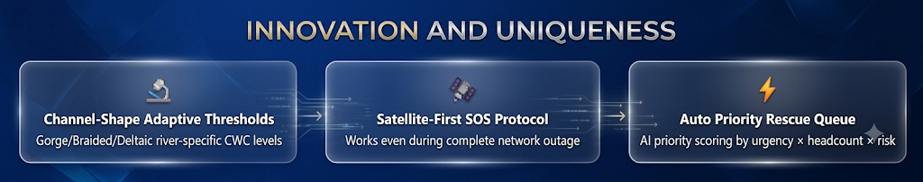
IDEA TITLE
Elites1417
The Problem
Our Solution
Flash floods in Himalayan basins strike within minutes of cloudburst — zero lead time
Traditional downstream gauge systems miss upstream gorge funneling dynamics
No unified multi-source platform (rain + river + soil + DEM)
4,000+ lives lost annually to floods in India (NDMA 2023)
Cellular blackout prevents SOS signals during peak disaster
Rescue dispatch is manual, slow, and lacks priority scoring.
Multi-source risk engine: Rainfall + River Rise + CWC Thresholds + Soil Saturation + DEM slope
28+ real Indian rivers registered with CWC gauge threshold bands
Automatic danger breach detection → instant SMS alerts + rescue priority queue
Satellite SOS: 128-byte compressed binary packet — works with ZERO cellular
GIS interactive risk map with real-time rescue lifecycle tracking
RBAC portal for Citizens, Rescue Teams, Govt & Admins.

Slide 3
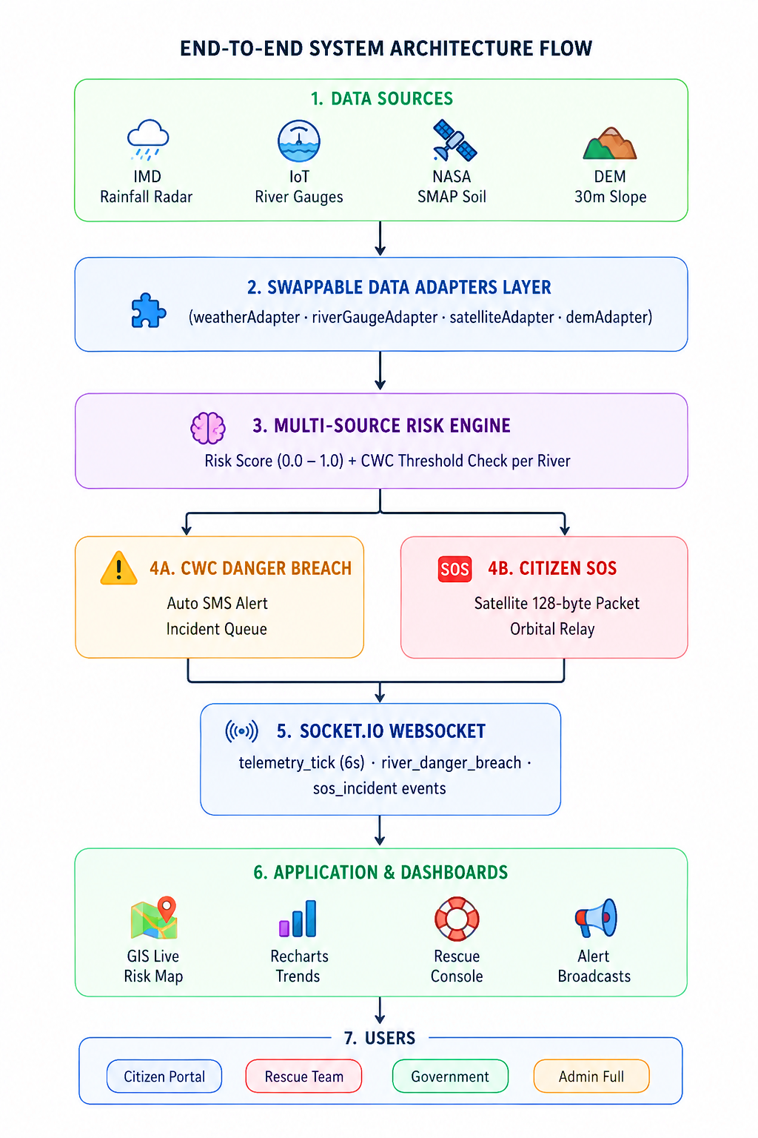
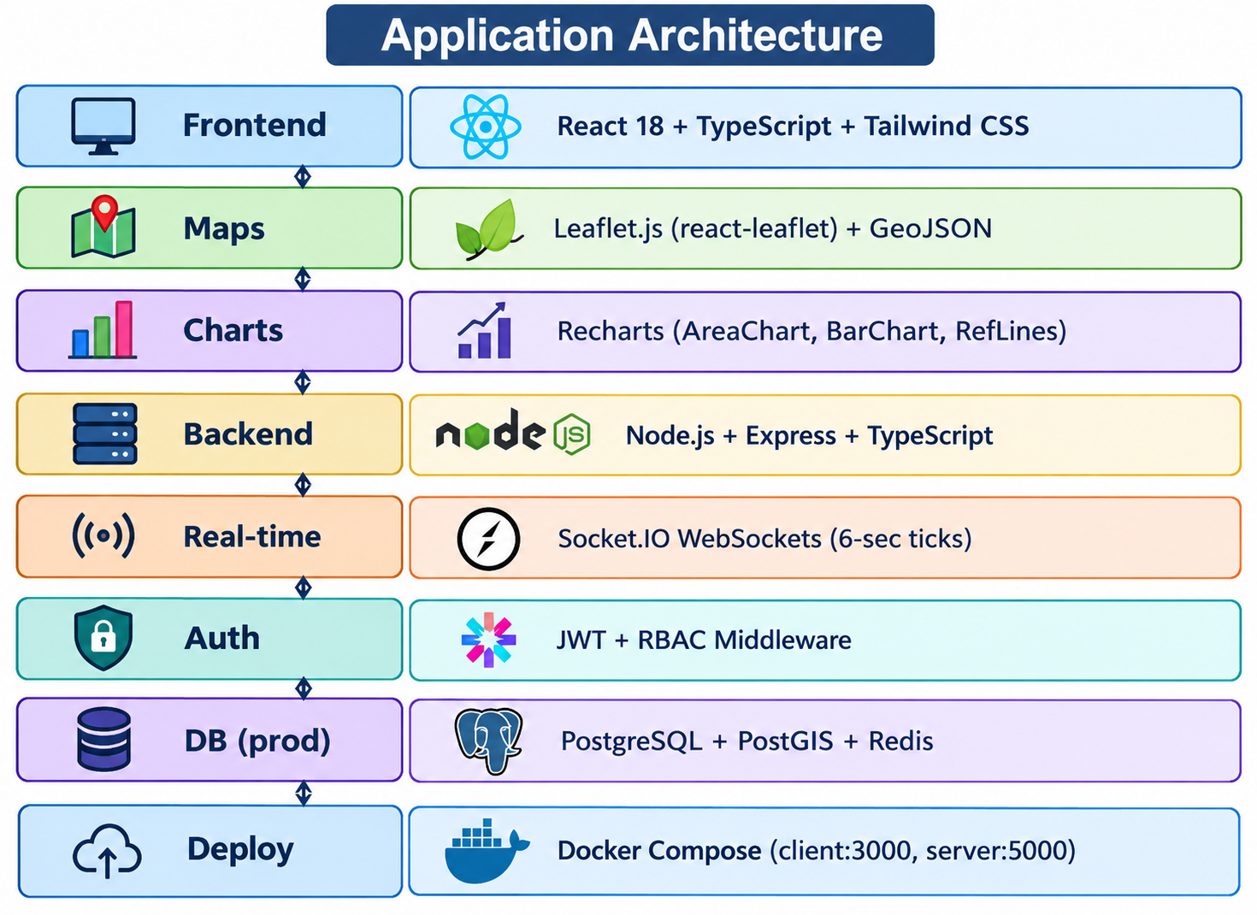
TECHNICAL APPROACH
Elites1417
Technology Stack

Slide 4
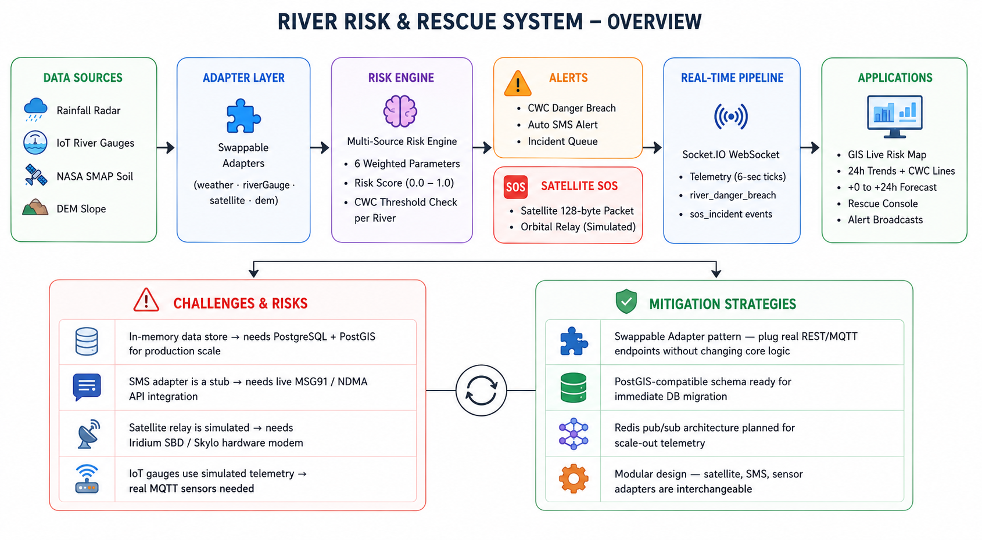
FEASIBILITY AND VIABILITY
Elites1417

Slide 5
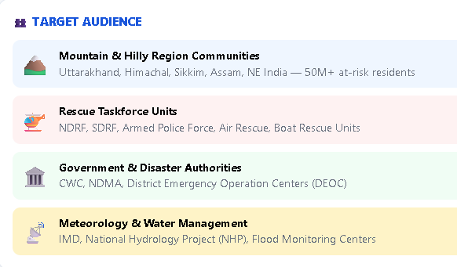
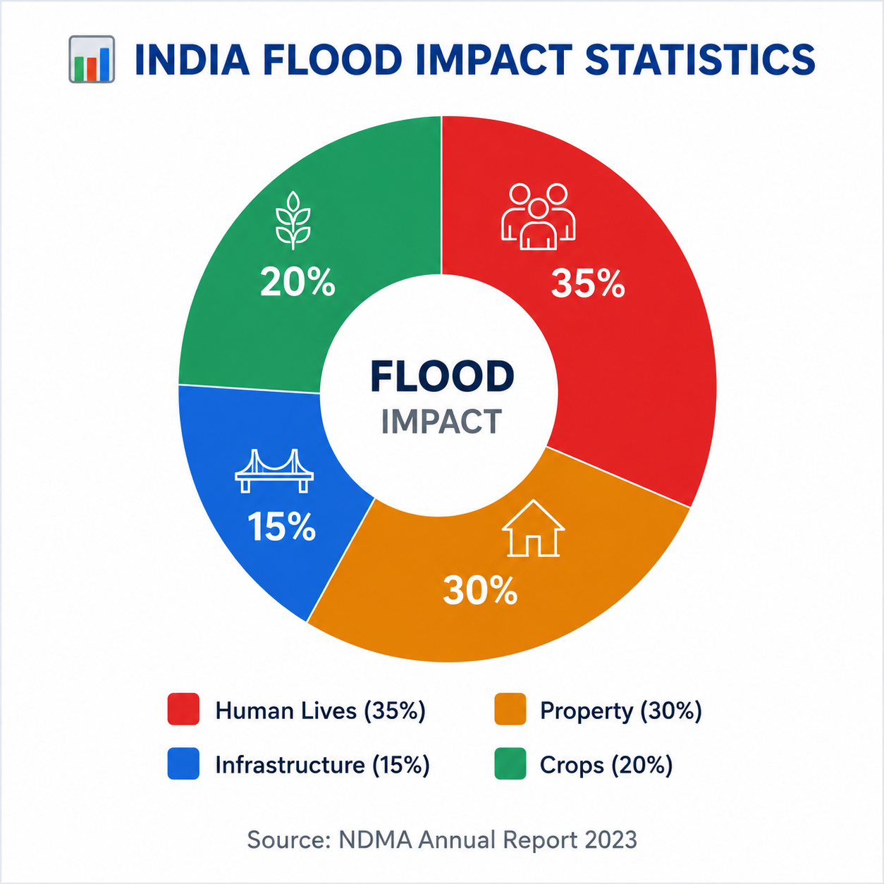
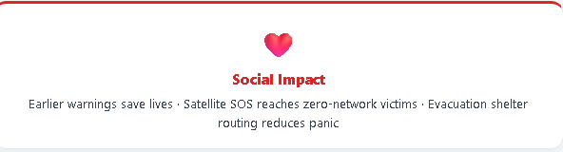

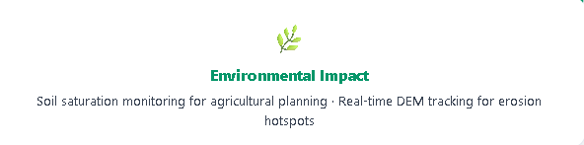
IMPACT AND BENEFITS
Elites1417

Slide 6
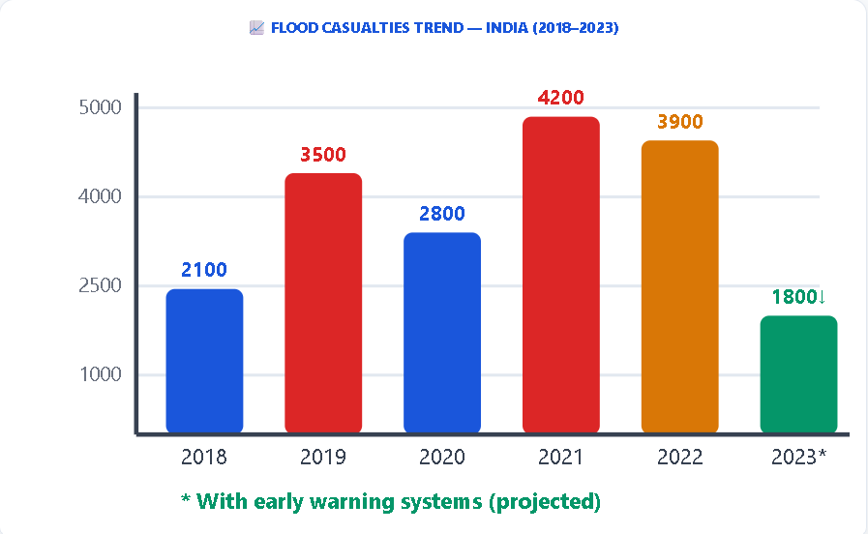
RESEARCH AND REFERENCES
Elites1417
Key Research and References
CWC India – Central Water Commission Gauge Classification Guidelines (2022)
NDMA India – National Flood Risk Mitigation Project Reports (2023)
NASA SMAP – Soil Moisture Active Passive Satellite L3 Dataset
IMD API – India Meteorological Department Rainfall Radar Data Feeds
Sentinel-1 SAR – ESA Copernicus Flood Inundation Mapping
USGS DEM – 30m Digital Elevation Model for Himalayan Watersheds
Nepal Flash Floods 2024–2026 – OCHA Situation Reports (Himalayan benchmark)
Iridium SBD Protocol – Short Burst Data for Satellite IoT Messaging
Skylo API – NarrowBand Satellite Gateway for IoT (India)

